Slide 1
Time Series Analysis on Pollutant Gases
Air pollution contributes to over 4.2 million deaths annually.
Root cause will take time to solve, but governments need mitigation measures in the meantime, like getting employers to ensure the safety of workers.
For these measures to work, governments need to keep track of air pollution.
This is typically done using sensors, which track the concentration of pollutants.
The Problem: Using this data, can we forecast future levels of air pollution?
Gases:
Carbon Monoxide: Burning of Fossil Fuels
Non Methane Hydrocarbons: Road Vehicles
Nitrogen Oxides: Road Vehicles
Ozone: Reaction between Nitrogen Oxides and Volatile Organic Compounds (eg. NMHC)

Slide 2
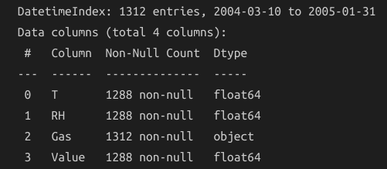
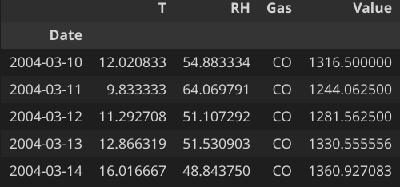
Air Quality Dataset
Data recorded by a set of metal oxide gas sensors in an Italian city
Contains information on the local temperature, relative humidity, and concentration of gas.
Data aggregated to daily frequency
March 2004 to February 2005
Missing values pre-filled to -200
Training Dataset: 1312 rows (24 NA rows)
Test Dataset: 256 rows (predict 63 days)
Notes:
https://scied.ucar.edu/learning-zone/air-quality/how-weather-affects-air-quality#:~:text=Temperature%2C%20Sunlight%2C%20and%20Humidity,the%20movement%20of%20air%20pollution.&text=The%20warmer%2C%20lighter%20air%20at,the%20ground%20to%20higher%20altitudes.
T
Temperature in degrees celsius
Affects the movement of air pollution due to convection currents
Also affects the creation of pollution: e.g. more Ozone is created in higher temperatures
RH
Relative Humidity in percentage
Ratio of amount of water vapour in the air to how much water vapour the air could contain at that temperature
Higher humidity may worsen air pollution
Gas
Type of gas being measured
CO (Carbon Monoxide), NMHC (Non Metanic HydroCarbons), NOx (Nitrogen Oxides), O3 (Ozone)
Value
Daily averaged estimated concentration of pollutant
All measured in different units.

Slide 3
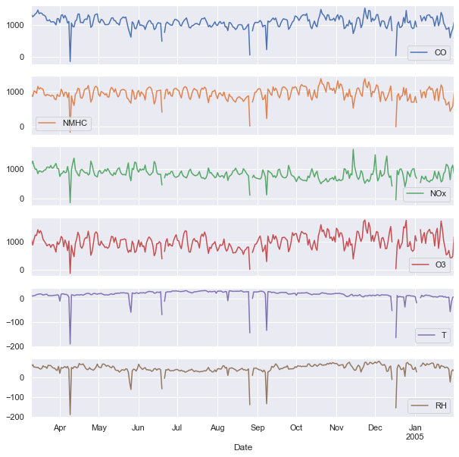
EDA Findings
Initial Look
Missing Data appears to happen around downward spikes in the time series
Temperature: There is a upward non-linear trend in temperature from April to August, before the trend changes direction to become downwards.
Relative Humidity: - There is a downward trend in relative humidity from April to August, before the trend changes direction to become downwards. The trend appears to be non-linear. Inversely proportional to temperature
NOx: There is a small non-linear downward trend. A possible reason might be due to new EU standards for catalysts to be installed on vehicles, resulting in lower NOx emissions from vehicles. (47% of the reduction in NOx emissions from 1990 and 2011 come from vehicle emissions)
Notes:
Source](https://www.statista.com/statistics/809161/nitrogen-oxides-nox-emission-trend-in-italy/)
[Source](https://www.eea.europa.eu/data-and-maps/indicators/eea-32-nitrogen-oxides-nox-emissions-1/assessment.2010-08-19.0140149032-3#:~:text=The%20sectors%20responsible%20for%20the,distribution%27%20(contributing%2027%25).)

Slide 4


EDA Findings
Missing Data
When one value is missing, the values for the whole day will also be missing
Stationarity of Data
ADF test conducted on all gas variables; All except temperature were found to be stationary at a 5% significance level
Thus, the data does not need to be differenced.
Temperature is not stationary, but relative humidity is
Seasonal Decomposition of Data
Discovered that seasonal period appeared to be 1 week
Found that for Carbon Monoxide, strength of seasonality in the data was weak ( close to 0)
Strength of seasonality of all gases was too weak to require seasonal differencing.

Slide 5
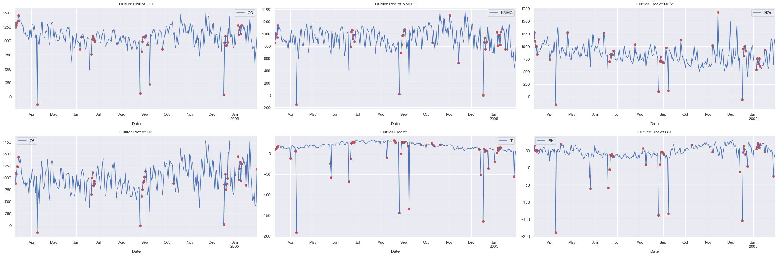
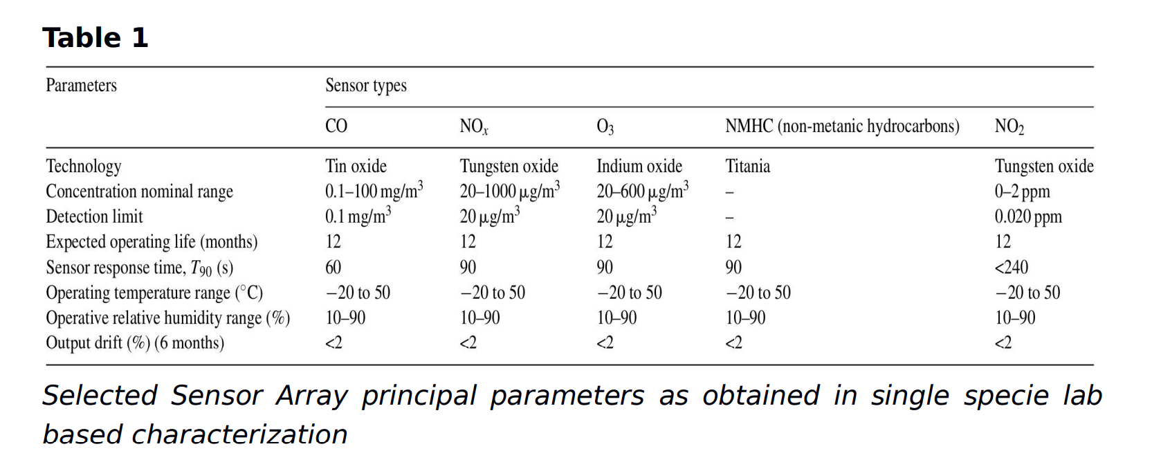
EDA Findings
Data Anomalies for Temperature, Relative Humidity, and Concentration
Rolling Outlier Detection was Utilized with a 1 Week Window & Background Research used to determine outliers
Generally, the temperature and relative humidity values line up with those typical of Italy
Presence of impossible values as outliers,
Negative relative humidity (RH is a percentage)
Extremely cold temperatures
Negative concentration of gases
Conclusion: result of sensor errors, and should be treated, explainable outliers to be left in dataset

Slide 6
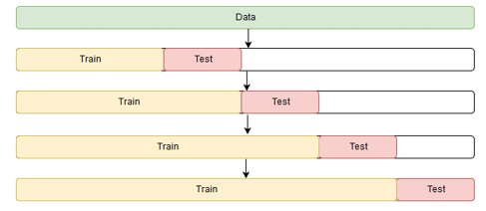
Data Preprocessing & Forecasting Evaluation
Preprocessing
Pivot the dataset from long to wide format
Mark “impossible values” as missing
Impute all missing values using interpolation
Evaluation Method
Time Series Cross Validation with 4 Splits
Test on approximately two months of data for each split
Look at the average test RMSE of the models for model selection, avoiding models that are heavily overfitted (training RMSE vs test RMSE)

Slide 7
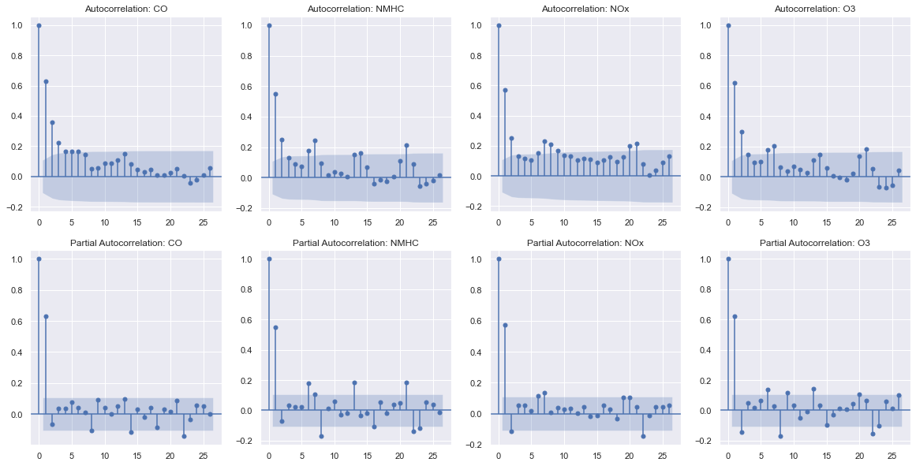
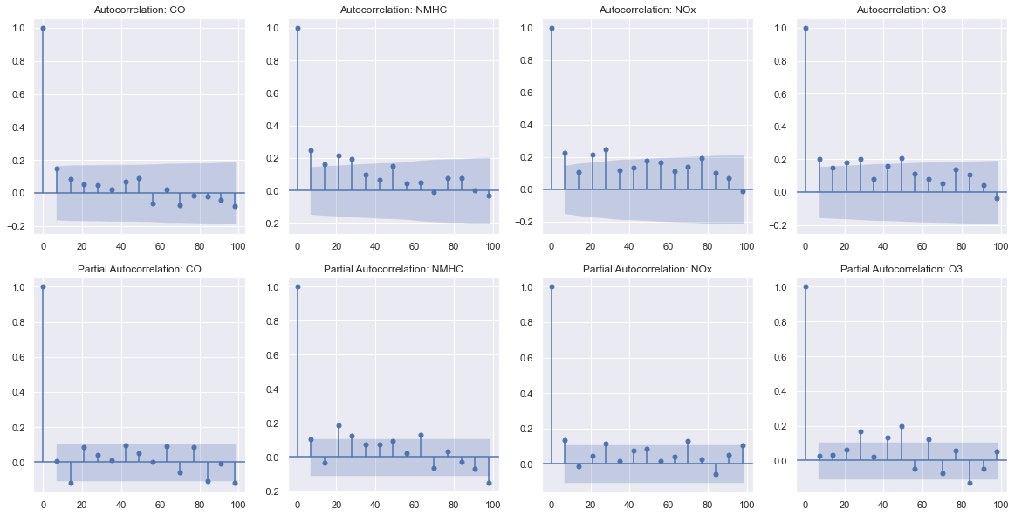
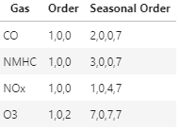
Identification of Order
ACF and PACF Plots Were Analysed to Identify the Order and Seasonal Order of the Data;
From the PACF plot, an AR(1) pattern was detected for all four gases, with a possible MA(2) for O3
Seasonal lags (multiples of 7), used to identify seasonal order

Slide 8
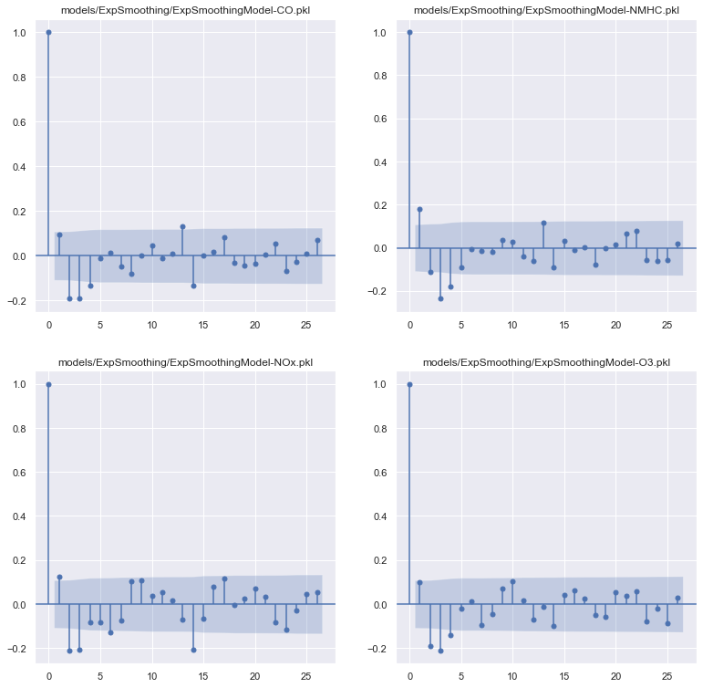
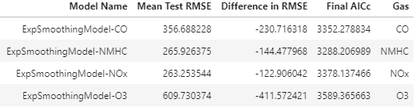
Modelling
Exponential Smoothing
Exponential Smoothing model with additive trend and seasonality was tested as a baseline
From the mean test RMSE, the model predictions are poor.
Residuals were found to have significant autocorrelation, suggesting a poor fit to the data

Slide 9
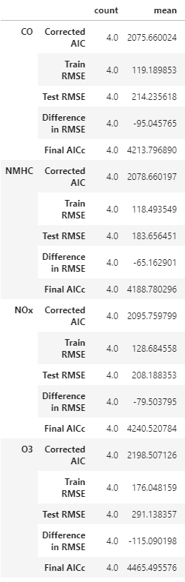
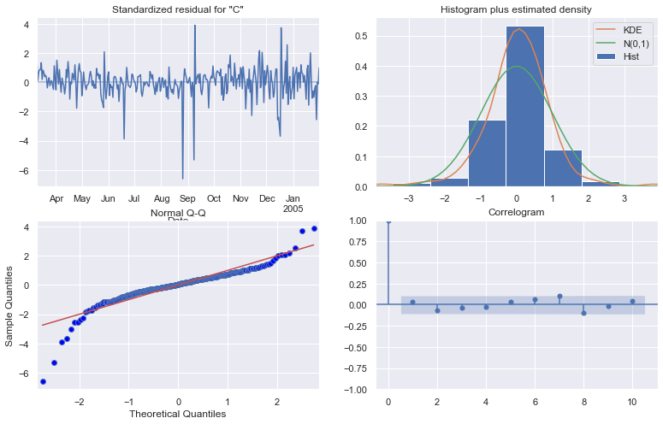
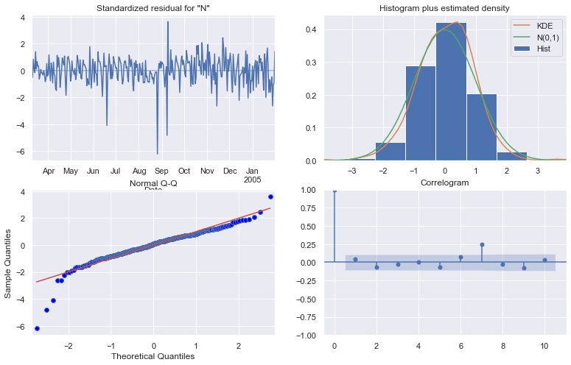
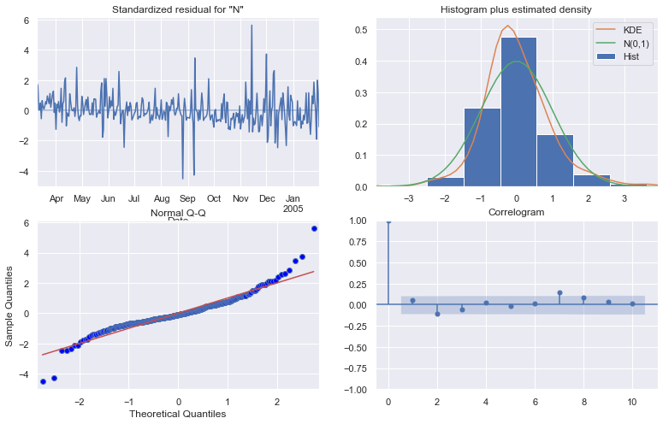
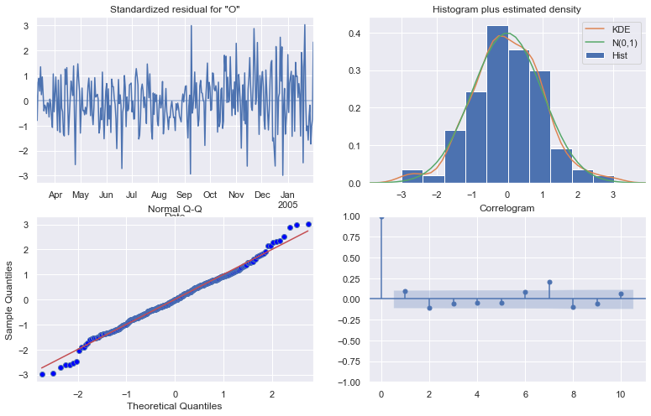
Modelling
ARIMA
ARIMA model was built using the identified orders
ARIMA models all performed better than the exponential smoothing models
Ljung-Box test showed no significant autocorrelations in the residuals

Slide 10
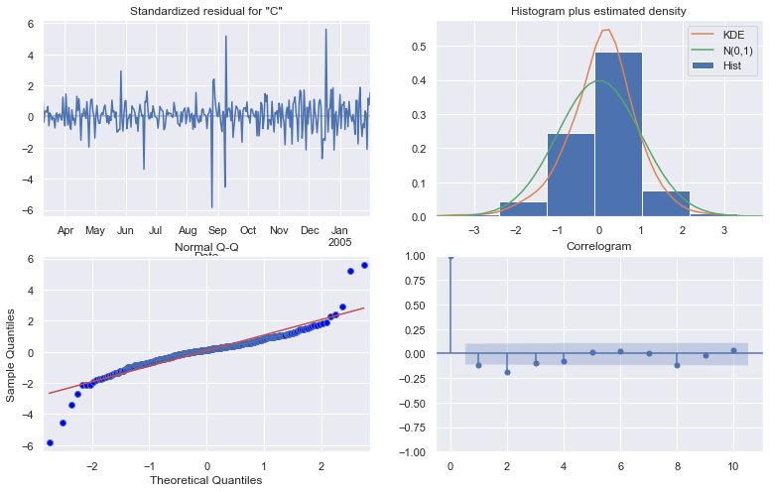

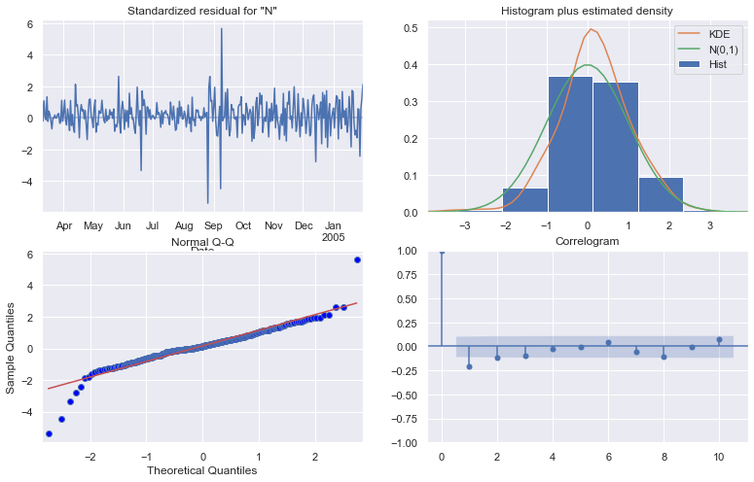
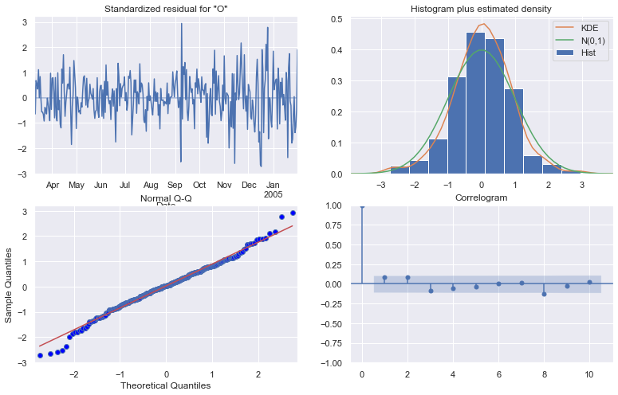
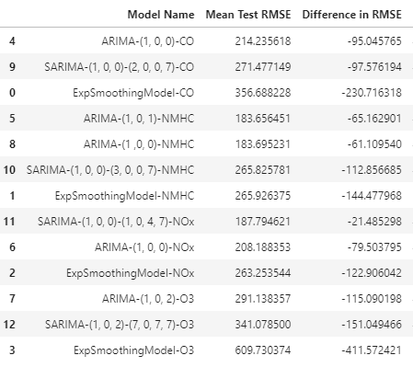
Modelling
SARIMA
Found that SARIMA outperformed ARIMA for NOx, but not the other gases
For CO and NMHC, there was significant correlation in the residuals, suggesting a poor fit

Slide 11
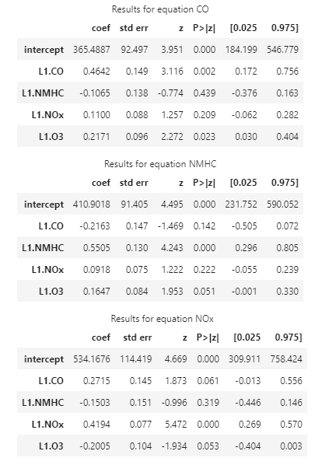
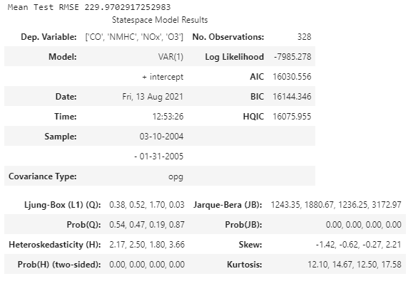
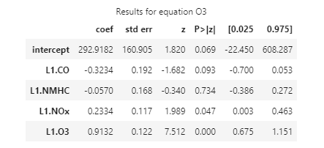
Modelling
VARMA
VARMA model was tested on the data, but did not produce significantly different results from individual ARIMA models
Found that for almost all the gases, the terms from the other gas were not significant

Slide 12
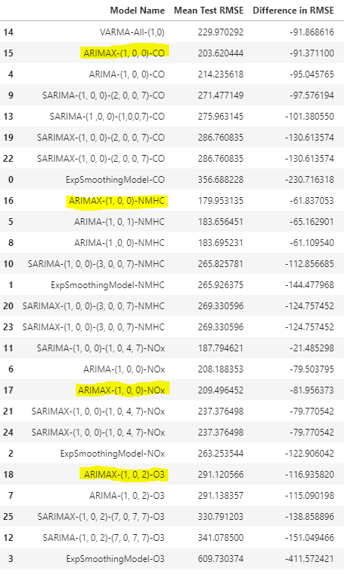
Modelling
ARIMAX and SARIMAX
Using the same orders from ARIMA and SARIMA, exogenous variables (Temperature and Relative Humidity) were added to the data
ARIMAX was found to be an improvement over ARIMA for all gases except for NOx
For SARIMAX, just adding the exogenous variables without changing the order made the model worse and increased overfitting. This suggest tuning has to be done to identify a better seasonal order before SARIMAX performs better

Slide 13
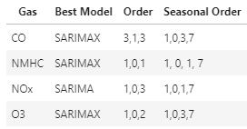
Model Improvement
ARIMA with Seasonal Decomposition
STLForecast was used to add seasonality to ARIMA models without using SARIMA
This did not end up improving the performance of the ARIMA models
Adding Seasonal Dummies
During EDA, noticed that weekends tended to have different concentration levels, so feature engineering was done to add a dummy variable for weekends
Found to improve the SARIMAX model for NOx, but not any other gases. Since it also caused the model to overfit more, decided not to use it.
Hyperparameter Tuning
A cross validated grid search was conducted on the order and seasonal order on ARIMA, ARIMAX, SARIMA and SARIMAX
From all the searches, the models with best RMSE were selected

Slide 14
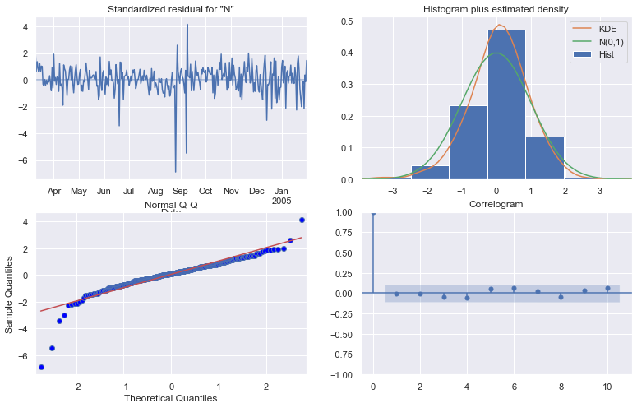
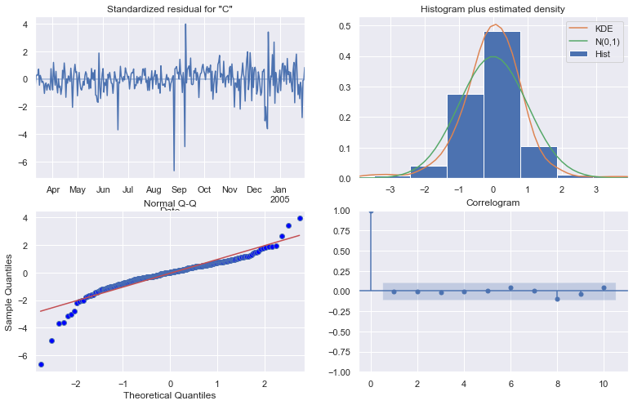
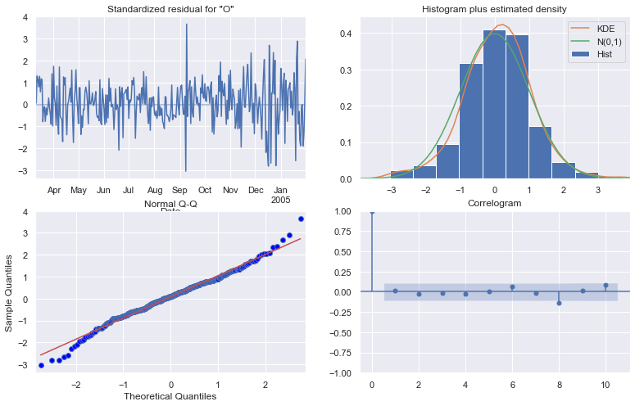

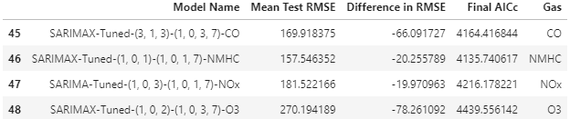
Final Models Evaluation
Ljung-Box Test: All four SARIMA/SARIMAX models were a good fit to the data, as there was no autocorrelation in the residuals
Many of the parameters of the models had high p-values, indicating they were not significant. This suggests further improvement could be made to the model to make it more robust.

Slide 15
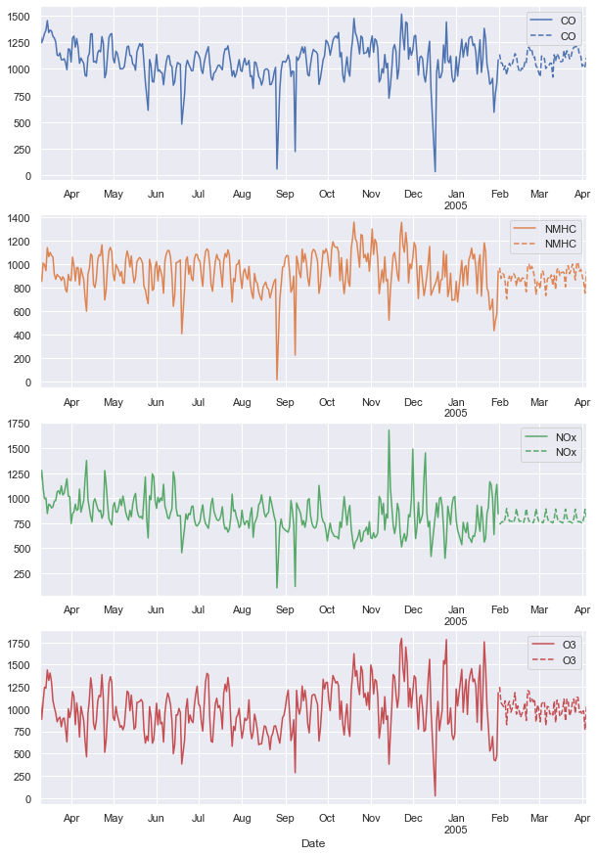
Forecast and Conclusion
Forecasts were done on the final models, and plotted out.
Overall, the predictions appear to be fairly decent, but seem to have a lower variance than the training data points
Future Improvements:
More exploration into VARMAX
Ensemble Modelling: Combining Multiple predictions from different models to produce better predictions

